Slide 1
PPP Training Program
3.4 Case Studies of Managing & Completing PPP Feasibility Studies

Slide 2
Discussion Questions:
PPP Feasibility Studies can take a long time to prepare and complete. What the Biggest challenges to efficient completion of PPP Feasibility Studies in Tanzania?
When PPP Consultants & Transaction Advisors are used in Tanzania to complete feasibility studies, what are the most important techniques to overseeing and managing them effectively?

Slide 3
Bucharest Water Concession – Lessons Learned
El Pliego Method:
No protests
26 months from mobilization to award
Requires investing more time and money in developing clear, measureable required service standards and full concession contract “up-front”
Clearly define, in advance, any restrictions to increases in real tariff
Link approval of tariff increases with attainment of pre-defined levels of service

Slide 4
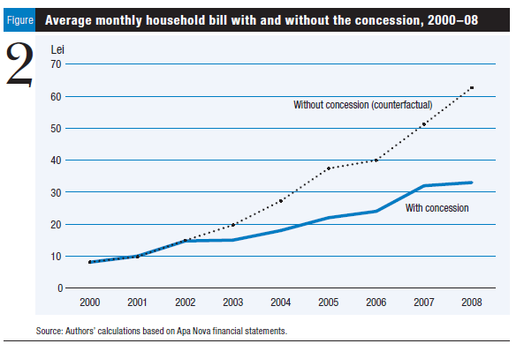
Comparing Average Household Water Bills: “With Concession” vs. “Without”

Slide 5
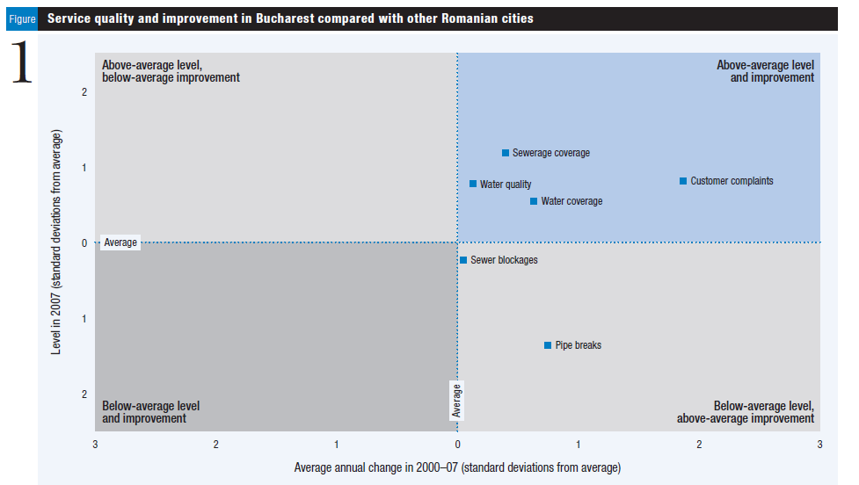
Comparing Water Service Quality: Bucharest vs. Other Romanian Cities

Slide 6
Performance of the Bucharest Water Concession
Significant overall improvement in water quality levels, in-line with EU sector standards
Tariffs have increased: 11% average annual increase (2000=$0.18/m3… 2009=$1.13/m3) still below other Romanian cities & EU averages.
Efficiency savings (reduced UFW) significantly help limit water tariff increases
Independent Evaluation (2009) estimated current VfM savings for $349 million (33% less) or $1 billion over full 25-year concession term
Total “advisory costs” (including for IFC) = $6.1 million

Slide 7
PPP Procurement Results
3 of 6 Prequalified Bidders Submitted Bids
Bid Tariffs were much lower than expected
IFC Financial Model projected AT in the range of US¢ 40-50/Cu M
Winning bid was about US¢ 18/Cu M

Slide 8
Selection of the PPP Winner
T_{o} = Baseline Tariff
Bid tariffs subject to a maximum
Bid T₁₆
Bid T₁₁
Bid T₇
Bid T₆
Bid T₄
Bid T₃
Bid T₂
Bid T₁
T₁
T₂
T₃
T₄
T₅
T₆
T₇
T₈
T₉
T₁₀
T₁₁
T₁₂
T₁₃
T₁₄
T₁₅
T₁₆
T₁₇
...
T₂₅
Winning Bid = Lowest AT =
(T₁+ T₂+ T₃ + 2T₄ + 5T₆ + 5T₁₁ + 10T₁₆)
25

Slide 10
7 Tariff Bids associated with Concession Years 1, 2, 3, 4, 6, 11, and 16
Should be blank
Check that the information is correctly filled. Name/signature must match with that on the Power of Attorney

Slide 11
Concession Prequalification Criteria
SPV Ownership and Control
Acceptable Private Operators or Consortia controlled by or affiliated with Acceptable Operators
Technical Qualifications Criteria
Population served, # of connections, system size, water and waste water treatment experience)
Financial
Net worth
Debt:Equity Ratio / Credit Rating

Slide 12
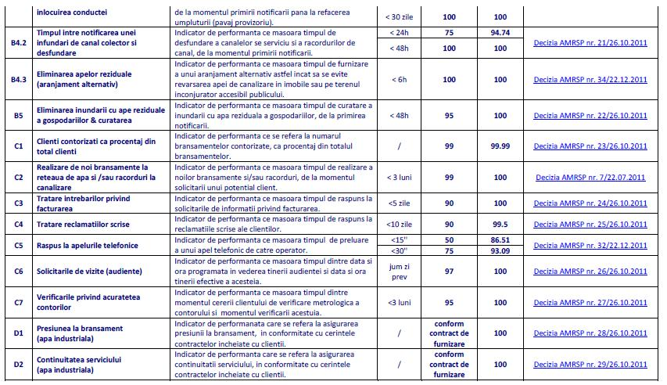
Concession Contract’s 24 Specific Output Levels of Service (in Romanian…)

Slide 13
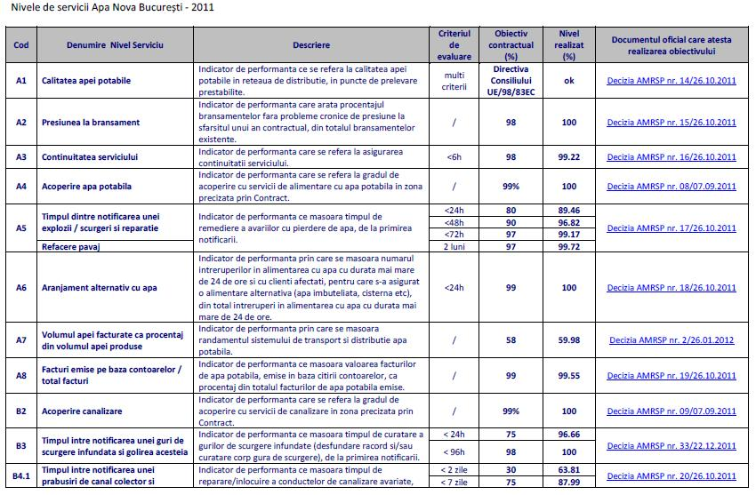
Concession Contract’s 24 Specific Output Levels of Service (in Romanian…)

Slide 14
Concession Procurement Structure
Strict pre-qualification requirements and no “technical bid”
Two envelope system:
Envelope A: Signed concession contract, shareholders agreement, capital contribution agreement, concession company by-laws, bid bond, certificates of compliance, etc.
Envelope B: Tariff bids
Detailed levels of service
November, 2000: Bid submission, opening and evaluation on same date, open to public, and proceedings videotaped with computer model projected on screen
Award based on single parameter – lowest weighted average tariff (net present value) over life of concession

Slide 15
Bucharest Municipal Govt. Objectives
Meet European Union water distribution and quality service levels of service at the lowest tariff for consumers
Free municipal budget from financial burdens of subsidizing a poorly-performing public service
Secure public support for a PPP solution
Timetable (2000 election year)
Move Quickly !

Slide 16
El Pliego vs “Conventional” PPP Procurement
El Pliego
Prequalification
Discussions on Contract w Prequalified Firms
Tender Issued w Final Contract Specifying Performance
No Technical Proposal
Tenders Returned w Signed Contract
“Conventional” PPP
Prequalification
Tender Issued w Contract Outline
Tender Requires Technical and Financial Proposals
Evaluate and Award
Negotiate Final Contract w Selected Bidder

Slide 17
PPP Procurement Characteristics
1998: IFC engaged as the PPP transaction advisor
Competitive procurement (three strong bidders)
First concession awarded on tariff bid only (no technical bid) –”The El Pliego” Method”

Slide 18
Bucharest, Romania Municipal Water Concession Procurement
2.3 MM Population
Poor water quality and low water pressure
City’s budgetary means insufficient (limited national help)
Near 100% Coverage
92% Direct Connections; 8% Stand Pipes
Over 800 lts/capita/day demand for water (four times EU average)
Unaccounted for Water (UFW) = 50%
Low Tariffs (US¢ 17/m3)
Receivables—Municipal District Heating Co. (one third of water production)
Largest water sector PPP in Central and Eastern Europe
Estimated new investment needs US$ 1.0 billion

Slide 19
DC Roads PPP Case: Lessons Learned
Make it clear that the payments start after the contractor demonstrates that work on each of the maintenance categories is underway
Identify the Govt’s Project Manager at the beginning of procurement and involve him/her throughout procurement process
Include damages in the contract for failure to comply with time-critical performance measures
Include incentive/disincentive clauses for exceeding or for failure to meet performance measures
Share positive results with politicians, the public, and the press

Slide 20
VMS & Growth of PPPs for Road & Transport Asset Maintenance Market
VMS launched in 1996, based in Richmond, VA
First PPP Contract: Virginia DoT’s Interstate Highway Asset Management Contract
Similar Highway Asset Management Contracts for State DoTs in Alaska, Texas, Oklahoma, Florida, etc.
By 2000, VMS Inc. was 10th Fasting Growing Company in the USA (by Inc. Magazine)

Slide 21
How VMS Controls Costs:
70% of work is contracted-out to local DC firms; VMS itself performs 30%
VMS is not required to follow lengthy, costly & bureaucratic public procurement regulations
“Just in Time” Maintenance:
Engages multiple sub-contractors
Lower price through competition
Increases costs only when needed
No carrying costs for downtime
Management Systems:
Proprietary VMS system controls planning, delivery, & evaluation of all work
Investment Orientation:
All road rehabilitation project investments are designed & implemented to achieve operating & maintenance cost savings

Slide 22
PPP Contract Results
Estimated Value for Money (VfM) savings of 15 – 20% for Govt.
Lower maintenance costs
Higher levels of service
Assured outcomes (force of a clear contract)
Entire backlog of roadway maintenance eliminated

Slide 23
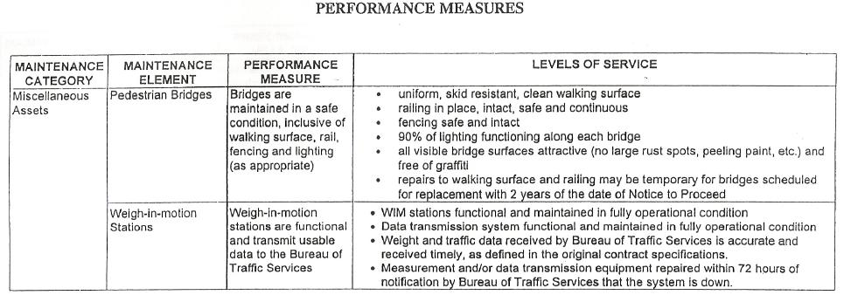

Slide 24
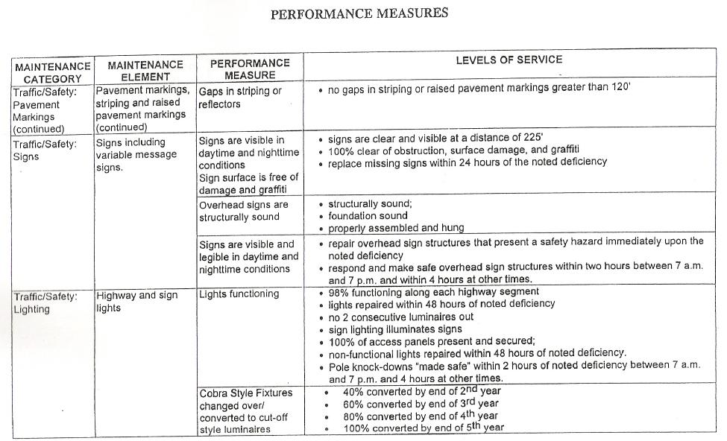

Slide 25
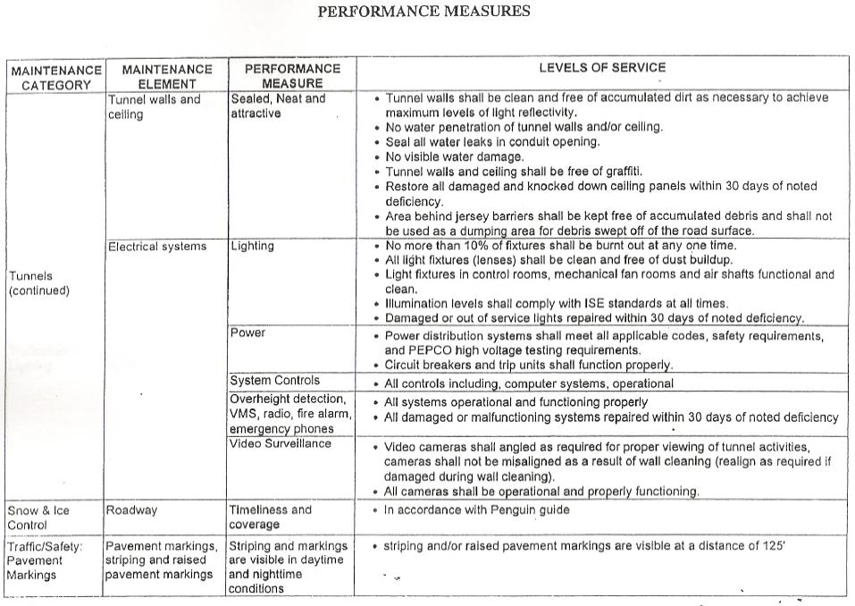

Slide 26
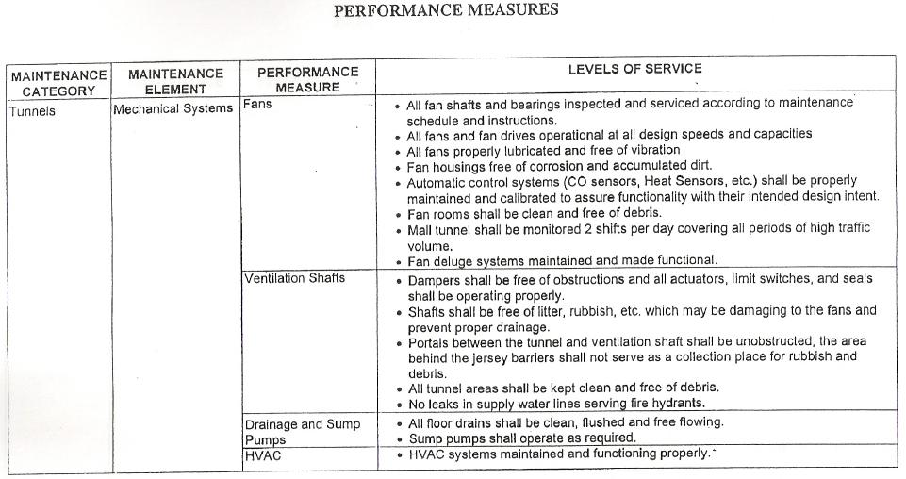

Slide 27
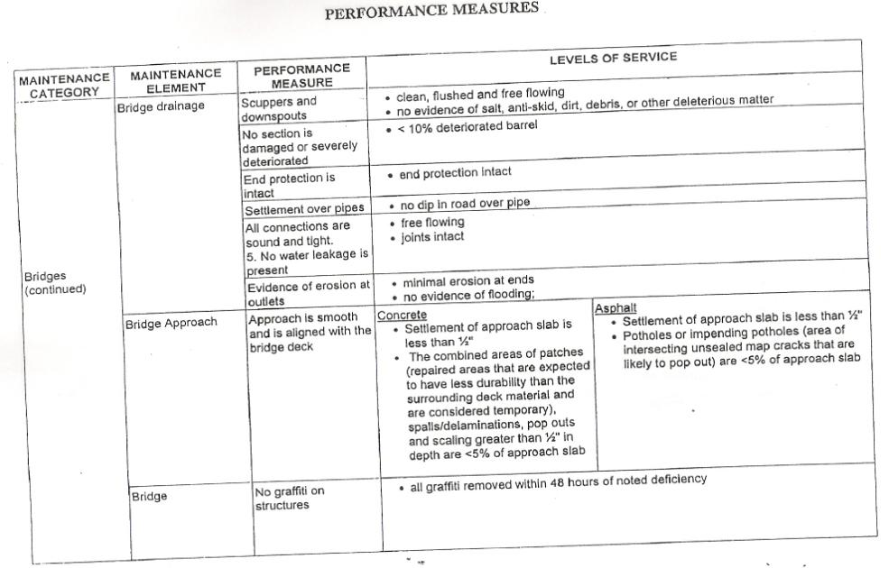

Slide 28
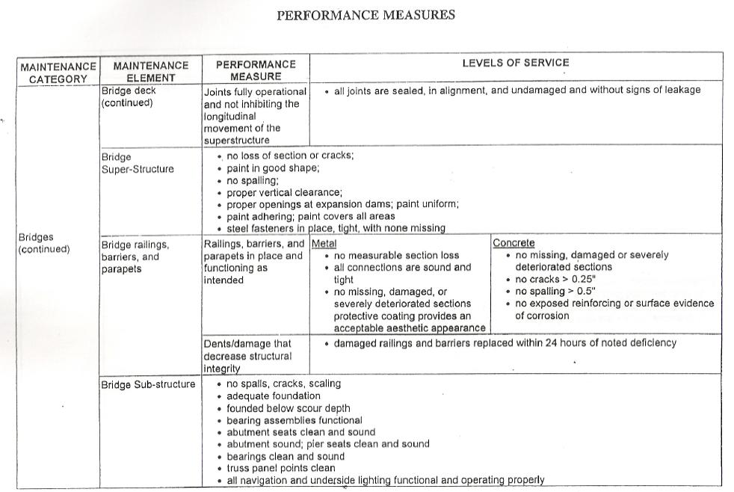

Slide 29
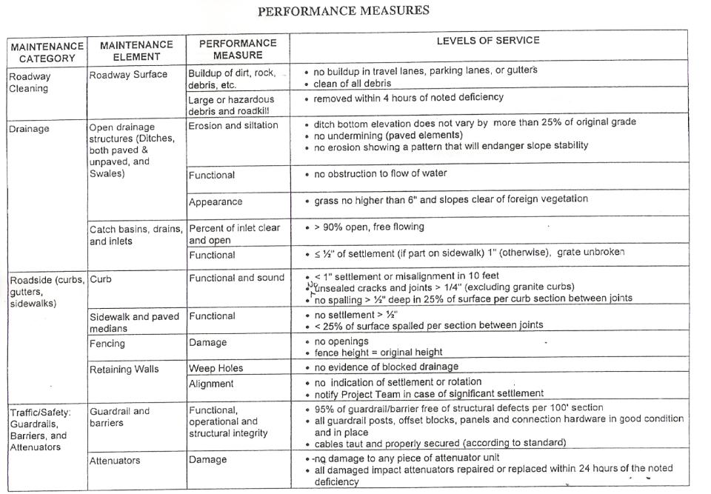

Slide 30
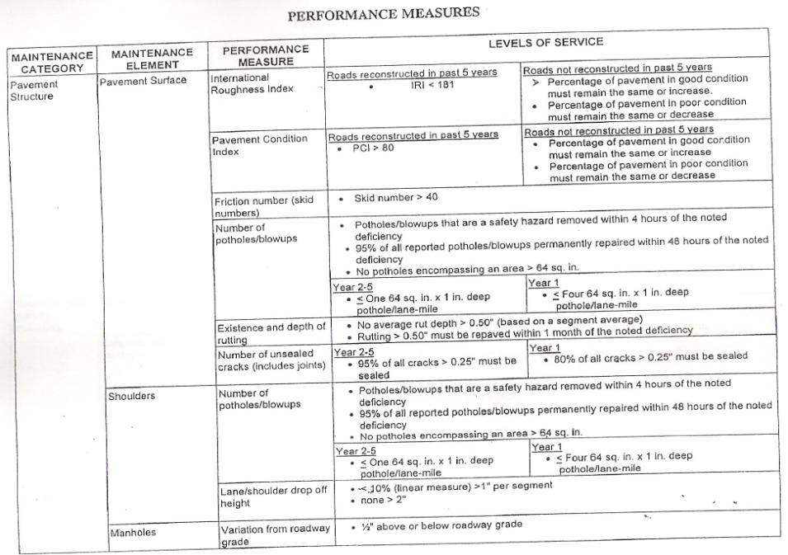

Slide 31
Performance-Based Roadway Asset Preservation Contract
Contract executed: June, 2000
Contract Term: 5 years
Contractor: VMS, Inc. (Richmond, VA)
Contract Amount: $69.6 million (60 installments)
Objectives:
Provide DC residents with cleaner, safer, smoother roadway & roadside assets
Extend the life of roadway assets & improve level of service
Encourage innovative methods, procedures, and processes for infrastructure maintenance
Reduce maintenance costs and develop cost-effective solutions
Institutional performance-based contracting

Slide 32
PPP Contract Tendering:
Nov. 1998: Formal cooperation between U.S. Federal Highway Admin. And DC Dept. of Transport to explore a performance-based option for DC highway maintenance
VMS submits concept for performance-based contract based on its similar experience in Virginia
Dec. 1998 – Oct. 1999: DC DoT with SAIC (advisors) define highway assets inventory, establish performance measures, & issue RfP
Feb. 2000: Four private companies submit technical & costs proposals
April 2000: VMS Inc. selected (best tech. proposal & lowest price)
June 2000: Contract signed

Slide 33
PPP Initiative
Experimental initiative based upon cooperation between DC’s Dept. of Public Works & U.S. Federal Highway Administration: performance-based contract
Focused on 75 miles (120 km) of both Federal Highway System Assets and heavily-used local arterial roads
PPP Contract the defines level of service a private contractor must provide for each defined asset class element
Contractor is not told what to do, or how to do it, but instead, “what must be achieved.”
First of its kind urban, performance-based roadway asset preservation contract of its kind in USA

Slide 34
District of Columbia
Area: 16 km X 16 km
Population: 600,000 within DC, 3 million in Metropolitan Area (Virginia & Maryland)
Total Street & Bridge Network: 1,091 miles (= 1,750 kms.)
33 miles (52 kms) of Federal Highway System Assets in District
Additional 42 miles of heavily-used local arterial roads

Slide 35
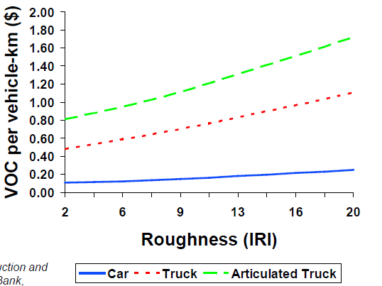
Road Roughness (IRI = International Roughness Index) Effects on Vehicle Operating Costs

Slide 36
Problems facing DC’s Roads
1990’s: Problem across the USA of lack of maintenance & renewal of highway & road assets built in 1950’s & 1960’s
Costs of roadway maintenance & renewal had risen substantially
Late 1990’s Fiscal Crisis for Government of District of Columbia. Sub-investment grade credit rating. Taken-over by Federal Government-appointed Financial Management Board
Condition of DC Roads (2000)
21.6% = Fair to Poor Condition (PCI 0-60)
31.1% = Good Condition (PCI 61-80)
47.3% = Excellent Condition (PCI 81 – 100)

Slide 37
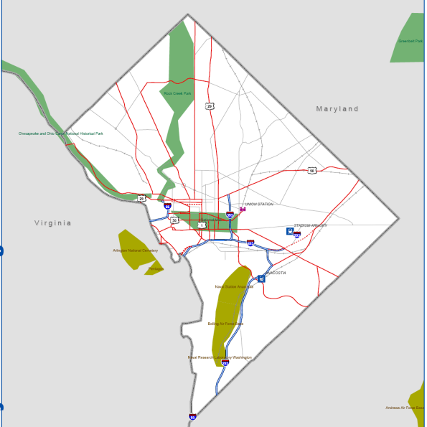
PPP Output Performance Standards Example: Washington, DC’s Federal Highway System Asset Maintenance PPP

Slide 38
Matrix Tool for Identifying & Defining PPP Output Performance Standards
No. | Output Standard Category | Rationale for Output Standard | Performance Indicator (How will it be measured?) | Verification (How will performance be verified) | Responsibility (ie Private, Public, or Shared)
1
2
3
4
5
6

Slide 39
Facilities Management Contract Performance Standards
Repair and Maintenance
Building fabric including walls, doors, windows, sanitary conveniences and washing facilities, paintwork etc as well as external areas including pathways, roofs, bridges, car parking areas and roadways within the boundaries of the property.
Maintenance of boilers, water and plumbing, sprinkler systems, air-conditioning, refrigeration, lifts, fans, lighting, combustion appliances and fuel storage systems as well as design, installation, inspection and testing of all electrical and mechanical equipment covered by the contract.
Functionality testing of equipment and systems – particularly life saving and security systems.
C6 –Minor Improvements – Fabric Repair & Maintenance
C7 – Internal Moves
C9 – Security Equipment & Guarding
C10 – Cleaning
C11 – Waste Disposal
C12 – Internal Plants and decoration
C13 – Grounds Maintenance
C14 – Water and Sewerage
C15 – Energy
Business Support
D2 – Catering
D3 – Reception Services
D4 - Courier and External Distribution
D5 – Post Room Internal Distribution
D6 – Reprographics
D7 – Disaster Recovery & Business Continuity

Slide 40
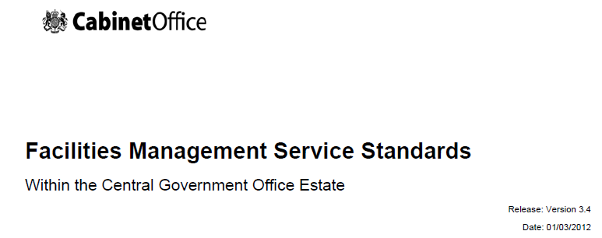
Facilities Management Contracts: Standardized Output Requirements
Typically applied to Social and Commercial Infrastructure facilities that provide accommodation for high numbers of citizens, tenants, retailers, passengers, etc.
Applied to Schools, Hospitals, Correctional Facilities, Public Sports & Recreational Complexes, Public Sector Office Buildings, Market Places, Transportation Terminals, etc.

Slide 41
A Good PPP Output Specification must:
Reflect the actual requirements of the services by end-users and consumers
Be clear, concise and unambiguous
Give the potential bidders sufficient information to decide and cost the facilities and services
Comply with legal or other statutory requirements and technical compatibility requirements of the project
Increase the benefits of combining design, construction & operation
Allow projects to be evaluated in the procurement process against defined criteria
Identify those service areas which are critical to the availability and performance of the facility
Only contain requirements that can be afforded by the client and are deliverable

Slide 42
PPP Output Specifications
Why Do we need Output Specifications?
Needed for a clear PPP contract and the successful delivery of long-term services
The emphasis is on
service outcomes and outputs
explicit allocation of risks and
the integration of design and build with the operation of service facilities
It focuses on strategic needs rather than the detail of current provision
It should allow innovation for the private sector to select their own detailed design, construction, materials, equipment, operation, maintenance, and staffing of facilities to be proposed
It focuses bidders’ attention on project risks
This should lead to better designed and operated facilities in the longer term

Slide 43
Output-Based Perf. Indicators for PPPs
Level of demand/Capacity: Minimum level of demand that project must provide. Expressed as capacity provided, number of end users, volume delivered, etc.
Availability & Reliability: Percent of the time must the project’s services be available?
Access: Minimum distance from clients or end users?
Timing: Deadline for when these services must be available & termination deadline, etc.
Technical Quality Standards: Minimum levels of technical quality, sector-specific for buildings, electricity, water, roads, etc.
Facility Management (Appearance & Cleanliness): When possible, use Standard Industry Indicators for Facilities Management for standards for areas like the cleaning, appearance, etc.
Other sector & project-specific output standards: Each sector & project has unique key performance indicators. If these can be feasibly quantified and measured, include in output requirements.

Slide 44
Developing the PPP’s Output Specifications
What is an PPP Output Specification?
It is what the Client (public authority) needs to achieve from the new facilities and services to be provided.
It directs how the private bidders should reply to the Invitation to Tender
It details WHAT needs to be achieved,
NOT HOW it is to be achieved.
PPP Output Specification Requirements:
Clear & Unambiguously worded
Technically measurable/quantifiable
Legally enforceable
“Cost-able” (private bidders can confidently estimate all of the input costs needed to meet the output standards)

Slide 45
PPP Risk Identification/Allocation Matrix
14 | Operation | The project is not able to function and operate as fully as had been anticipated | This could reduce the project’s revenues, if it its outputs are lower than anticipated This could increase operating costs if more needs to be spent on operating costs to achieve higher levels of output. This could significantly delay construction if a new, corrected design must be completed and built. The private developer may have to pay penalties to the contracting agency if it is not able to the project’s minimum, contracted output or performance standards
15 | Maintenance | The project and its assets are not properly maintained | The project could face unscheduled outages, reducing its revenues, its creditworthiness and its profits The project may face higher and sooner-than-anticipated renewal and replacement costs on its un-maintained assets If the project is not able to meet its minimum, contracted availability standards, it will need pay liquidated damages to the public contracting authority
16 | Ancillary Features & Interconnections | Ancillary infrastructure services that the project needs, such as approach-roads, energy & water interconnection facilities, etc. are not provided and completed on time | This could delay the date when the project can earn its first revenues, reducing its creditworthiness for lenders and profitability for investors The developer may seek either price increases or damages from the public contracting authority or Government body responsible for completing and delivering the ancillary services on time.

Slide 46
PPP Risk Identification/Allocation Matrix
10 | Responsibility of Design | The project’s design is faulty or inappropriate to meet the required output performance standards | This could increase construction costs as new, more expensive designs would have to be completed and built This could increase operating costs more than anticipated as a result of having to follow a faulty or inappropriate design. This could significantly delay construction, adding interest costs during construction and delaying when the project can earn its first revenues Investors may require price or tariff increases from the Government or its contracting agency to be able to pay these higher construction and operating costs.
11 | Output Performance Standards & Specifications | The project’s performance standards and design specifications are inappropriate for the project’s needs | This could increase construction costs as new designs may have to be completed and built This could increase operating costs more than anticipated as a result of having to follow an inappropriate design. This could significantly delay construction, adding interest costs during construction and delaying when the project can earn its first revenues The private developer may have to pay penalties to the contracting agency for not be able to the project’s minimum, contracted performance standards
12 | Procurement & Construction Completion | Completion of the project construction was delayed | This could increase construction costs through higher interest-during-construction costs This could delay when the project can earn its first revenues The private developer may have to pay liquidated damages to the public contracting authority for not being able to begin operations by the contracted deadline
13 | Construction Cost | Total construction cost was more than anticipated | This would reduce the profitability of the projects for its owners, and the creditworthiness or coverage ratio for its lenders Lenders may require more investments, such as reserve accounts, from owners Investors may try to request price or tariff increases from the Government or its contracting agency.

Slide 47
PPP Risk Identification/Allocation Matrix
5 | Currency Availability & Transferability | Foreign currency is not available to transfer funds from local to hard currency Profits earned by the PPP project inside the country cannot be repatriated to its owners outside the country | If this risk is present during the tendering phase, then international bidders will not bid on the project, and the tender may fail If this risk is present during the operating phase, investors will not be able to earn their projected financial returns, and may seek disputes, termination or damages.
6 | Operating Costs | The costs of operating the project are higher than they were expected to be | This would reduce the profitability of the projects for its owners, and the creditworthiness or coverage ratio for its lenders Lenders may require more investments, such as reserve accounts, from owners Investors may try to request price or tariff increases from the Government or its contracting agency.
7 | Interest Rate | Interest rates on the loans used to finance the constructing & start-up of the project increase | This would reduce the profitability of the projects for its owners, and the creditworthiness or coverage ratio for its lenders Lenders may require more investments, such as reserve accounts, from owners Investors may try to request price or tariff increases from the Government or its contracting agency.
8 | Exchange Rate | The local currency depreciates in value relative to the hard currencies in which the PPP project’s loans and equity investments are denominated | This would reduce the profitability of the projects for its owners, and the creditworthiness or coverage ratio for its lenders Lenders may require more investments, such as reserve accounts, from owners Investors may require price or tariff increases from the Government or its contracting agency to be able to pay these higher debt service return on equity costs.
9 | Market/Demand | The actual quantity of outputs or services demanded by users or the off-taker is less anticipated The project’s tariffs or prices are not adjusted according to the escalation formula agreed upon | This would reduce revenue and therefore also the profitability of the project for its owners, and the creditworthiness or coverage ratio for its lenders Lenders may require more investments, such as reserve accounts, from owners Investors may view this a contract violation and thus seek disputes, termination or damages.

Slide 48
PPP Risk Identification/Allocation Matrix
# | Risk Name | Risk Description | How this Risk Impacts the Specific PPP Project
1 | Land Availability & Acquisition | Land needed for the project is not available or has not been acquired. There uncertainty over how much it would cost to acquire needed land and its timing | This could increase the construction cost of the project beyond what is planned This could significantly delay construction, adding interest costs during construction and delaying when the project can earn its first revenues
2 | Land Unsuitability | Unanticipated adverse ground conditions are discovered | This could increase construction costs as new lands need to be identified and purchased This could increase construction costs as more expensive pilings or foundation strengthening must be built. This could significantly delay construction, adding interest costs during construction and delaying when the project can earn its first revenues
3 | Environmental | The project causes major environmental impacts on its surrounding natural resources | Thousands of neighboring residents dependent upon these natural resources could lose their livelihoods, or lives. The project could have to pay significant new, large sums to mitigate or correct these environmental damages The project could have to pay significant new, large sums in fines, penalties, or punitive damages The project may have to cease operations altogether or until it has successfully mitigated the damages
4 | Health, Safety & Permits/Licenses | The PPP Project Company does not receive the construction, environmental labour permits, operating licenses, etc. required for the project Regulations and standards on health, safety, permitting, licenses, etc. are not complied with. | Workers or neighboring residents could suffer poor health, injuries, or other safety consequences. The project could have to pay significant new, large sums to mitigate or correct these health/safety damages The project could have to pay significant new, large sums in fines, penalties, or punitive damages The project may have to cease operations altogether or until it has successfully corrected these violations

Slide 49
PPP Risk Analysis & Structuring
IDENTIFY all relevant risks for a given project
ANALYZE both the size of each risk event happening and the probability of its occurring
Decide how to ALLOCATE each risk between the public and private sectors (including sharing)
Market Testing: Confirm if this risk allocation structure really is acceptable to both interested private contractors and to the Govt. (ie. The level of public sector support that would be required)
A good, clear risk identification, analysis & allocation
should make it easy for a qualified PPP lawyer to
develop a clear, full draft of a PPP contract in the
tendering phase.

Slide 50
Berat PPP Feasibility Study Conclusions
PPP Financial analysis indicate s that the project would not be financially viable based only on the revenues from selling of recyclable and composting materials.
The concession becomes viable and cost effective if the city of Berat agrees to share the risk of covering legitimate and justifiable costs that are related to service management and some of the capital cost, therefore allowing the concessionaire to recover the investment costs and generate a reasonable calculated annual profit.
The city would pay an average solid waste collection fee to the private partner equal to 243,027 € /year or 12 % less that the current costs of waste collection by the City.
Thus, projected VfM Savings = 12%

Slide 51
Estimating PPP Revenues:
Sales of Recycled Products
Revenues from selling of recyclables and composting material are based on the current prices of the domestic market in 2012 as reported in the Waste Strategy for Tirana, Albania developed by JICA study team.
Price items | Unit price €/ton
Price of mixed recyclable plastic | 114,29
Price of mixed recyclable paper/cardboard | 43
Price of mixed recyclable glass | 71
Price of mixed recyclable metal non – ferrous | 429
Price per unit of compost | 21

Slide 52
Berat: PPP Capital Investment and
Operating and Maintenance (O & M) costs
Capital costs:
Equipment
Construction
Depreciation
O & M Costs
Labor and Insurance
Current expentidures (utilities)
Administrative costs
Taxes and other
VAT
Cost items |  | Capital (Euros) | Annualized O & M and Public Education (Euros)
Containers |  | 440.925 | 425.702
Trucks |  | 190.000 | 2.554.035
Recycling Facility |  | 270.000 | 1.232.355
Composting facility |  | 270.000 | 736.335
Education & Awareness |  |  | 105.000
Euro |  | 1.170.925 | 5.053.427
Leke |  | 163.929.500 | 707.479.780
TSh |  | 2.9 billion | 12.6 billion

Slide 53
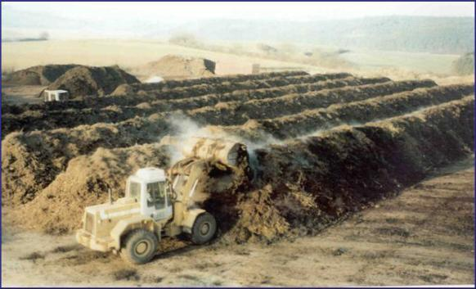
Berat: SMW Composting Facility
Composting facility
Initial capital cost: 270,000 € - 325 000 €
Capacity: 10,000 tonnes/year
Land surface: 2 ha
Annualized operating costs: 790,000 €

Slide 54
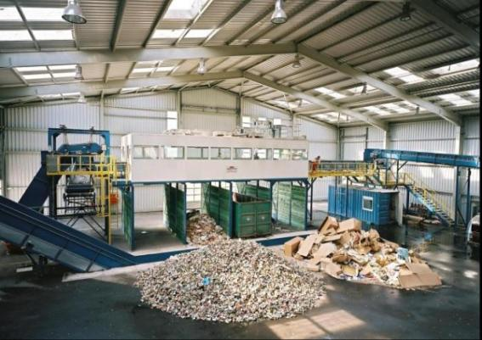
Berat: SMW Recycling Facility
Recyclable segragation facility
Initial capital cost: 270,000 € - 326,000 €
Annual Operating Costs: 1.28 million €
Capacity: 20 tonnes/day
Land surface required
(at no cost): 1 – 2 ha,
Covered area: 1,500 – 2,000 m2

Slide 55
Recovery of
recyclable wastes
Recovery for composting

Slide 56
Projections of Municipal Waste Recovery
Recovery ratio of recyclable materials |  |  | % of recovery
Recovery rate of recyclables year 1 |  |  | 25%
Recovery rate of recyclables year 2 |  |  | 30%
Recovery rate of recyclables year 3 |  |  | 35%
Recovery rate of recyclables year 4 |  |  | 40%
Recovery rate of recyclables year 5 |  |  | 50%
Annual Growth in Recovery rate of recyclables after year 5 |  |  | 2%
Recovery rate of waste for composting |  | %
Recovery rate organic waste for composting from 2013-2019 |  | 0%
Recovery rate organic waste for composting year 1 (2020) |  | 50%
Recovery rate organic waste for composting year 2 |  | 55%
Recovery rate organic waste for composting year 3 |  | 65%
Annual Growth in Recovery rate organic waste for composting after year 3 |  | 3%

Slide 57
Berat: Survey Assessment of Waste Generation
Families & Businesses | Total weight | % of Total weight
Total | 25252,9 | 100%
Mixed | 18191,0 | 72%
Recycleables: | 7061,9 | 28%
Paper | 3427,3 | 14%
Plastic | 2596,1 | 10%
Glass | 865,3 | 3%
Metal | 144 | 1%
Textile | 29,2 | 0%

Slide 58
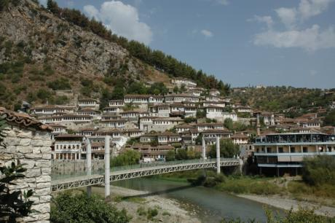
Waste Recycling PPP Case Example: Berat, Albania
GDP/Capita/Yr.: $4,400
Population of City of Berat: 65,000
Population of Region: 173,000
Current Solid Waste quantity estimated at 54 ton/day (1,23 kg/person/day)
Current total annual cost of Waste Collection & Disposal for the City:
= USD $395,000
= TSh 800 million

Slide 59
Waste Recycling PPPs: Key Challenges
Cost-Recovery: Often the revenues from sell bulk recycled materials does not cover the entire costs of waste collection, separation, processing, and disposal of residual non-recyclable materials. In this case, the City may need to pay the private partner for collection, etc.
Municipal Benefits: Often the benefit to the municipality is not additional revenue-generation (ie revenue-sharing with the private partner). Instead it is avoiding having pay the current costs of waste collection & disposal.
Waste-Stream Quality: Municipal Solid Waste can be very heterogeneous. The percent of recyclable materials in the waste stream can vary greatly over time, and differ from what a PPP feasibility study & or PPP tender documents state. Municipalities are often required to guarantee minimum quantities & qualities of wastes for the private partner.
Managing Stakeholder Impacts: Often small-scale, low-income, informal, recyclers already depend heavily on existing waste collection systems (ie no formal recycling) for their livelihoods. A new PPP could completely remove their economic livelihood.

Slide 60
Waste Recycling & Processing PPPs
Municipal/
Local Govt.
Authority
Private
Owner
/Investor
Waste Recycling
Concession (Exclusive)
PPP Contract
Sale of Bulk
Recycled
Products
Equity
$
Bulk Purchasers of Recycled Products
Loans
PPP Private Partner
(Special Purpose
Vehicle – SPV)
Banks &
Lenders
Repayment
Collection of
Solid Wastes
Disposal of
Residual Wastes
Citizens &
Households
Local Businesses
& Institutions
LANDFILL

Slide 61
PPPs in Waste Recycling & Processing
A growing number of local government authorities & municipalities are implementing PPPs to recycle municipal solid wastes
Focus on:
Cardboard & paper materials
Plastics
Glass
Compostable organic materials
Common PPP structures are:
Concession: City grants exclusive license (ie “concession”) to private developer to collect & sort/process municipal solid wastes & then sell the recycled products

Slide 62
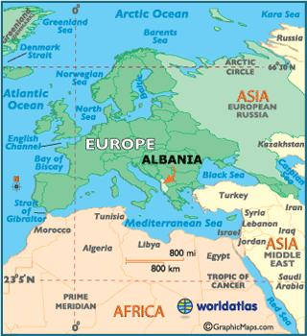
PPP Feasibility Study Analysis Case Study: Solid Waste Recycling - Berat, Albania
Albania: Population = 2.8 million
GDP Per Capita = $4,400/Year

