Slide 1
PPP Training Program
3.6 – 3.8: Group Exercise on PPP Feasibility Studies

Slide 2
PPPs in Waste Recycling & Processing
A growing number of municipal & regional governments are implementing PPPs to recycle municipal solid wastes
Focus on:
Cardboard & paper materials
Plastics
Glass
Compostable organic materials
Common PPP structures are:
Concession: City grants exclusive license (ie “concession”) to private developer to collect & process municipal solid wastes & then sell the recycled products

Slide 3
Waste Recycling & Processing PPPs
Gotham City
Government
Private Owner
/Investor
Waste Recycling
Concession (Exclusive)
PPP Contract
Sale of Bulk
Recycled
Products
Equity
$
Loans
PPP Private Partner
(Special Purpose
Vehicle – SPV)
Bulk Purchasers of Recycled Products
Banks &
Lenders
Repayment
Collection of
Solid Wastes
Disposal of
Residual Wastes
Citizens &
Households
Local Businesses
& Institutions
LANDFILL

Slide 4
Waste Recycling PPPs: Key Challenges
Cost-Recovery: Often the revenues from sell bulk recycled materials does not cover the entire costs of waste collection, separation, processing, and disposal of residual non-recyclable materials. In this case, the City may need to pay the private partner for collection, etc.
Municipal Benefits: Often the benefit to the municipality is not additional revenue-generation (ie revenue-sharing with the private partner). Instead it is avoiding having pay the current costs of waste collection & disposal.
Waste-Stream Quality: Municipal Solid Waste can be very heterogeneous. The percent of recyclable materials in the waste stream can vary greatly over time, and differ from what a PPP feasibility study & or PPP tender documents state. Municipalities are often required to guarantee minimum quantities & qualities of wastes for the private partner.
Managing Stakeholder Impacts: Often small-scale, low-income, informal, recyclers already depend heavily on existing waste collection systems (ie no formal recycling) for their livelihoods. A new PPP could completely remove their economic livelihood.

Slide 5
PPP Financial Model Case Example: Background on KERFLOKISTAN
Kerflokistan: An Emerging Market Economy
GDP per Capita per Year: $4,000
Population 40 million
Current crisis in infrastructure & public services due to decades of lack of public investment under previous single-party regime.
New economic reform policies of liberalization, competition, and private sector-led growth expected to increase economic growth from 1% to 4% over next 5 years.
Inflation projected at 7% for next 5+ years
New Government has launched a new Municipal PPP Unit (MP3 Unit) to identify and accelerate local Government PPP transactions in infrastructure

Slide 6
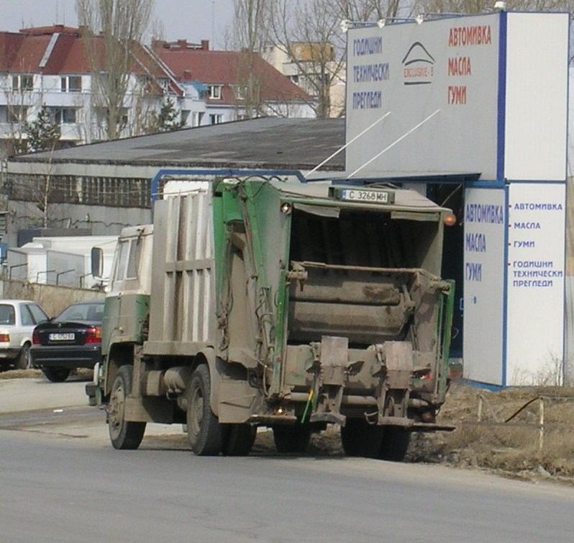
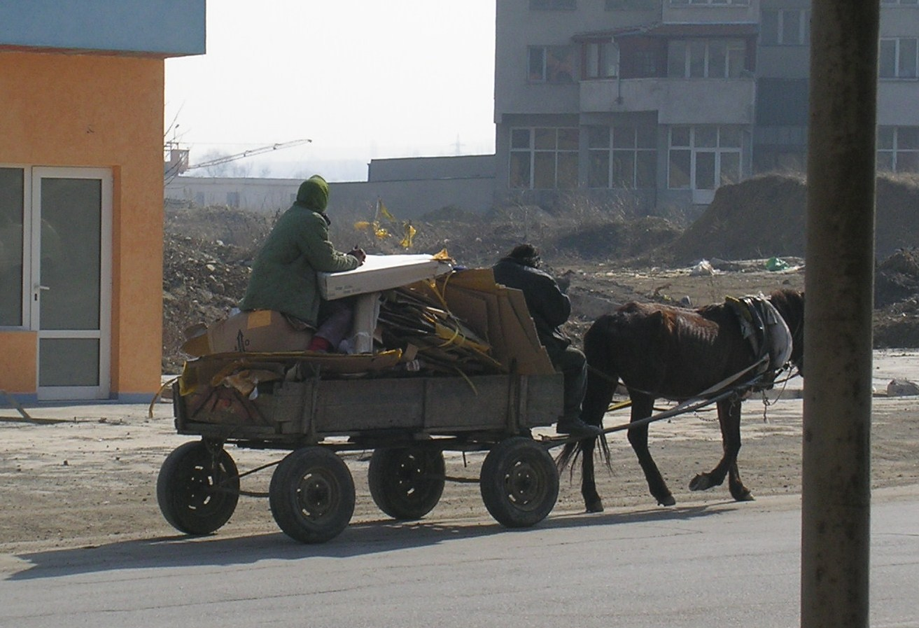
Current Waste Collection
By Gotham City
“Informal recyclers”

Slide 7
Gotham City, KERFLOKISTAN
Gotham City, a medium-sized city in Kerflokistan: population 300,000
Gotham City currently spends $1,000,000 per year on municipal waste collection & disposal
However, waste collection service is not reliable, due to inadequate maintenance of trucks. Illegal dumping of wastes along road-side and on vacant plots of land is common.
City has no official recycling program. However, recycling by low-income “informal recyclers” is reportedly common. No official data exists on the current levels of recycling by these informal recyclers.
National Policy is to encourage recycling and reduce waste generation, but there is no official plan yet, with clear targets or any clear financial incentives or supports for municipal government recycling investments
Gotham City lacks the funds to construct and operate a solid waste management recycling program to address the problem

Slide 8
Group Assignment #1
Identify all of the key stakeholders who would need to be included in this project as a PPP
Identify the most important risks facing each key stakeholder group
Propose how the risks should be allocated (or shared) between the stakeholder groups:
Government (Gotham City)
Interested Private Developers

Slide 9
PPP Financial Model
1-INPUTS & RESULTS
2-DEMAND: Vehicle Pop.
Projected Pop. over 20 yrs.
= Required Capacity
3-CAPITAL INVEST.:
Construction
Depreciation
4-FINANCING:
Debt (term, %, DSCR)
Equity (Gearing & RoE)
Loan Repayment Sched.
6-CASH FLOW STATEMENT
Net Income
+ Depreciation
- Debt Principal Paymnts.
= Cash Flow
DSCR
IRR
5-PROFIT & LOSS STATEMENT:
+Revenues(10 yrs.)
- O & M Costs
Interest expenses
Depreciation Exp.
Taxes
= Net Income
A.TARIFFS
Bulk-Purchasers/
City Support?
B. DSCR
Lenders
C. IRR
Investors

Slide 10
Gotham City Recycling Project Feasibility Study:Technical & Cost Estimations
Municipal Solid Waste Stream Analysis:

Slide 11
Capital Investments

Slide 12
Projected Revenues

Slide 13
Financial Model Results

Slide 15
PPP Case Exercise Questions:
What if the percent of recyclable wastes falls from 30% to 25%? Is the PPP project still bankable?
The proposed structure includes an annual payment from Gotham City of $200,000 per year? Is this beneficial to the City, or not? Should a PPP that is getting revenues from selling bulk recycled waste also receive an Availability Payment from the City – Or is this just wasting public money on “subsidizing private profits”?
Should the City offer to guarantee of minimum level of supply of solid waste to the private partner?
Should Gotham City ask for a revenue-sharing agreement, for revenues that are above a minimum-level?
What role should the City take regarding the impacts on the current informal recyclers in this PPP process?

Slide 16
Gotham City’s PPP Tender for Municipal Solid Waste Recycling
Gotham City issued a Request for Qualification (RfQ) & short-listed 4 private bidding consortia:
Roma Recycling Inc. (RRI)
Poa Kachizi Pickers, Inc. (BPI)
Enviro-Tech, Inc. (ETI)
Garbage-In & Garbage-Out (GIGO)

Slide 17
Gotham City Recycling PPP Structure
Concession structure: 10 year concession. Concessionaire earns its own revenues from sales of recycled wastes to bulk purchasers + payment from Gotham City
PPP Risk Category | Government | Private Concessionaire
Land Acquisition | Gotham City Administration
Construction Cost Risk |  | Private Concessionaire
Financing Risk |  | All financing for project is raised by the Private Concessionaire
Completion Risk |  | Private Concessionaire (Concessionaire provides a performance bond equal to 1 year of estimated annual revenues during construction)
Performance Risk (Ability to meet perform all required waste collection standards & procedures) |  | Private Concessionaire (Concessionaire provides a performance bond equal to 1 year of estimated annual revenues until year 20)
Demand Risk | Gotham City guarantees: A minimum annual payment to the private partner, set through competitive tender. | Private concessionaire assumes demand risks for any levels above the guaranteed annual payment from Gotham City.
Political & Regulatory Risks | Gothem City Adminstration
Inflation | Shared (Private Concessionaire may petition Gotham City Administration for payment changes due to inflation as needed during life of the contract) | Shared (Private Concessionaire may petition Gotham City Administration for price changes due to inflation as needed during life of the contract)
Environmental Risks |  | Private concessionaire is liable for any environmental impacts during the life of the PPP contract

Slide 18
Gotham City’s Recycling PPP Project Output Standards
Capacity:
Provide capacity to collect and sort up to 150,000 tonnes of municipal solid waste per year, and an average of 75 tonnes per day.
Ability to recover and to sell four different types of bulk recycled waste products:
Paper & Cardboard
Plastics
Glass
Metals
Ability to transfer and dispose residual non-recyclable waste projects in a sanitary landfill
Timing: Facility must be operational within 1 year of the private concessionaire’s reaching of financial closure for this project. Concession term of 10 years.
Performance:
Reliability: Private partner must be available to provide waste collection and recovery service 99% of the time, according to its scheduled hours of operations.

Slide 19
PPP Technical Proposal Evaluation Criteria: “Technically Responsive, or Not?”
Legal: Are all of the legal conditions and risk-allocation measures contained in the model Concession Contract acceptable to the private bidder?
Design: Is the design determined to be technically feasible and provide the capacity to meet the performance standards of the PPP project?
Timing: will the private partner be able to reliably provide the services by the required start date and throughout the 10-year life of the contract?
Strategy for Raising Financing: does the private partner have a realistic and practical plan for raising the financing required for the project?
Operating Plan & Performance: Will the private partner be able to meet all of the required technical performance output standards including both safety and emission standards?

Slide 20
PPP Technical Proposal #1: Roma Recycling, Inc. (“RRI”)
Legal Structure: All terms & conditions in the model Contract acceptable
Technical Design & Operation:
Construction of a 6,000 m2 Recycling Facility
Purchase of 6 trucks
Hiring of 75 total staff
Timing: Construction will be completed 12 months of financial closure
Strategy for Financing the Project:
Limited-recourse project financing basis, require 1 year reach financial closure
Operating Plan & Performance:
We will provide the capacity to collect & process 150,000 tonnes of wastes per year and an average of 75 tonnes per day
Reliability: Our facility will be available a minimum of 99% of the time Average inspection time:
Expected hours of facility operation: 9AM to 5PM (8 hours per day), 260 days per year (5 days per week)
Will meet all technical standards as required by the PPP Tender Documents

Slide 21
PPP Technical Proposal #2: Poa Kachizi Pickers, Inc. (“BPI”)
Legal Structure: All terms & conditions in the model Contract acceptable
Technical Design & Operation:
Construction of a 3,000 m2 Recycling Facility
Purchase of 4 trucks
Hiring of 125 total staff
Timing: Construction will be completed 12 months of financial closure
Strategy for Financing the Project:
Limited-recourse project financing basis, require 1 year reach financial closure
Operating Plan & Performance:
We will provide the capacity to collect & process 150,000 tonnes of wastes per year and an average of 75 tonnes per day
Reliability: Our facility will be available a minimum of 99% of the time Average inspection time:
Expected hours of facility operation: 7AM to 11PM (16 hours per day), 360 days per year (7 days per week)
Will meet all technical standards as required by the PPP Tender Documents

Slide 22
PPP Technical Proposal #3: Enviro-Tech, Inc. (“ETI”)
Legal Structure: All terms & conditions in the model Contract acceptable
Technical Design & Operation:
Construction of a 4,500 m2 Recycling Facility
Purchase of 5 trucks
Hiring of 90 total staff
Timing: Construction will be completed 12 months of financial closure
Strategy for Financing the Project:
Limited-recourse project financing basis, require 1 year reach financial closure
Operating Plan & Performance:
We will provide the capacity to collect & process 150,000 tonnes of wastes per year and an average of 75 tonnes per day
Reliability: Our facility will be available a minimum of 99% of the time Average inspection time:
Expected hours of facility operation: 9AM to 5PM (8 hours per day), 314 days per year (6 days per week)
Will meet all technical standards as required by the PPP Tender Documents

Slide 23
PPP Technical Proposal #4: Garbage-In, Garbage-Out (“GIGO”)
Legal Structure: All terms & conditions in the model Contract acceptable
Technical Design & Operation:
Construction of a 5,500 m2 Recycling Facility
Purchase of 6 trucks
Hiring of 80 total staff
Timing: Construction will be completed 12 months of financial closure
Strategy for Financing the Project:
Limited-recourse project financing basis, require 1 year reach financial closure
Operating Plan & Performance:
We will provide the capacity to collect & process 150,000 tonnes of wastes per year and an average of 75 tonnes per day
Reliability: Our facility will be available a minimum of 99% of the time Average inspection time:
Expected hours of facility operation: 9AM to 5PM (8 hours per day), 260 days per year (5 days per week)
Will meet all technical standards as required by the PPP Tender Documents

Slide 24
Working Group Assignments:
Evaluate each of these 4 Technical PPP proposals.
Decide whether each bid is “technically-responsive” or not.
(The next step will be the separate opening and evaluation of the PPP cost proposals.)

Slide 25
Opening of Cost Proposals: Gotham City Solid Waste Recycling PPP

