Slide 1

PPP Training Program
4.4 - 4.5: Group Exercise – Managing PPP Procurement

Slide 2
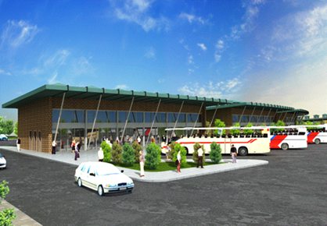
Instructions
Review project description
Pass/Fail Evaluation
Interviews SOQ Submitters
Subjective Evaluation
Shortlist 3 Firms

Slide 3
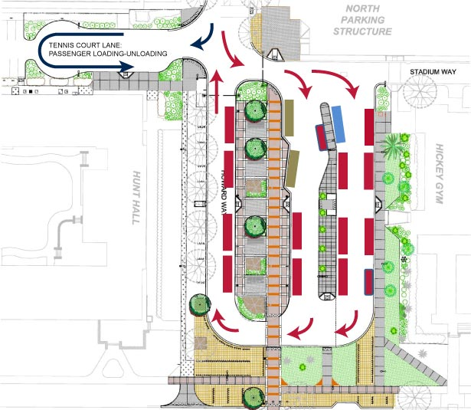
PPP Bus Terminal/Commercial Complex
Project Description
Investment Size | Estimated TZS 18 billion – Design Build Finance Operate Maintain
Concession Length | 25 years
Project Scope | Must accommodate approximately 80,000 passengers per day (20,000 from large buses and 60,000 from mini buses). Must contain commercial space.
Revenue | Bus entrance fees; commercial rents; parking fees.
Other | No promised government support

Slide 4
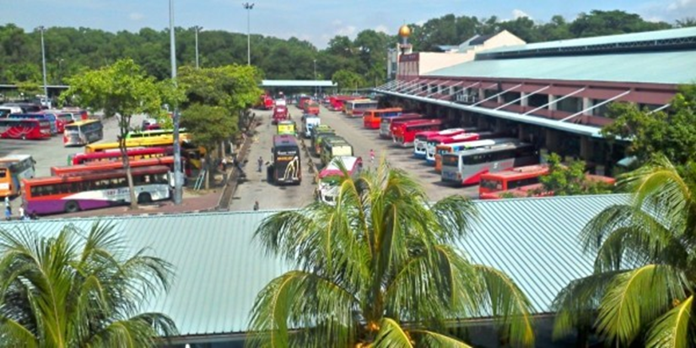
PPP Bus Terminal/Commercial Complex Evaluation RFQ Pass/Fail Review
Transmittal letter included
Proposer is capable of obtaining a performance bond, in an amount of at least equal to TZS 2 billion.
Proposer has not been disqualified, removed, debarred or suspended from performing or bidding on Government work.
Proposer includes planning, engineering, construction, operations & maintenance expertise, each with at least 15 years of experience.
Proposer has financial capability to execute Project.

Slide 5
PPP Bus Terminal/Commercial Complex RFQ Evaluation Criteria & Weighting
Project Qualifications and Experience (65% Weighting)
  Extent, depth, strength and likelihood of success of the Proposer’s and its individual team members’ experience with developing, designing and/or constructing comparable projects. (30 points)
  Experience of management team & key personnel. (30 points)
  Responsiveness toward including local contractor participation. (5 points).
Statement of Technical Approach (25% Weighting)
  The extent to which the Statement of Technical Approach demonstrates a full understanding of the Project’s scope and complexity (15 points)
  Extent to which the Statement of Technical Approach demonstrates a complete understanding of Project risks and potential solutions (10 points).
Safety Qualifications (10% Weighting)
  Strength & consistency of the Proposer’s & individual team members’ safety records (10 points).

Slide 6

AJM Qualifications – Pass/Fail
Criterion | Result | Pass/Fail
Transmittal Letter | Included
Performance Bond | Seeking a reduction to TZS 1 billion
Eligibility | No disbarments or suspensions.
Experience | < 15 years experience in planning & engineering. > 15 years in construction, operations & maintenance
Financial Capability | Financially sound. Will need to attract additional equity financing and will require government support

Slide 7
AJM Qualifications – Evaluation Criteria
Criteria | Submission | Score
Experience with similar projects (30 points) | Local construction and development firm with significant commercial experience in Tanzania. This would be first PPP project.
Management & key personnel (30 points) | Attracting talented local planning and engineering firms. Will self-perform construction.
Use of local contractors (5 points) | Has included local contractors as part of the team.
Understanding of project scope (15 points) | “Government wants to deliver project quickly and within budget.”
Understanding of risks (10 points) | “This is a Government project and as such should be willing to assume risks.”
Safety record (10 points) | Has been cited for construction accidents.
Total

Slide 8

Gargantuan Developer – Pass/Fail
Criterion | Result | Pass/Fail
Transmittal Letter | Included
Performance Bond | Meets bonding requirements.
Eligibility | No disbarments or suspensions. In litigation with another government on a PPP.
Experience | > 15 years experience in planning, engineering, construction, operations & maintenance
Financial Capability | Financially sound. Will syndicate equity.

Slide 9
Gargantuan Qualifications – Evaluation Criteria
Criteria | Submission | Score
Experience with similar projects (30 points) | Extensive international PPP social infrastructure experience. 2 toll-road projects. This would be first African PPP project.
Management & key personnel (30 points) | Experienced management. Assembled top planning, engineering and construction firms.
Use of local contractors (5 points) | Will consider local contractors for a small percentage of work, but no commitments.
Understanding of project scope (15 points) | “Government wants to maximize its share of revenue.”
Understanding of risks (10 points) | “Want Government to partially guarantee traffic.”
Safety record (10 points) | Generally good although a bridge collapsed on another project.
Total

Slide 10
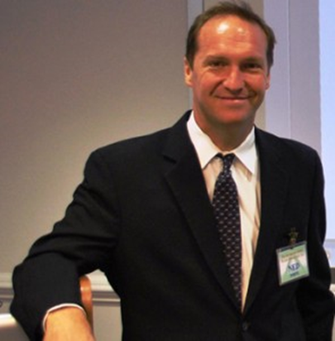
Ned White Development Ltd
Criterion | Result | Pass/Fail
Transmittal Letter | Included
Performance Bond | Can meet bonding requirements
Eligibility | No disbarments or suspensions.
Experience | > 15 years experience in planning, engineering, construction, operations & maintenance
Financial Capability | Financially sound. Will need to attract additional financing and will require government support

Slide 11
Ned White Development Ltd Qualifications – Evaluation Criteria
Criteria | Submission | Score
Experience with similar projects (30 points) | Extensive European PPP transport experience. This would be first African PPP project.
Management & key personnel (30 points) | CEO is former senior World Bank PPP official. Assembled top planning, engineering and construction firms.
Use of local contractors (5 points) | Has included local contractors as part of the team.
Understanding of project scope (15 points) | “Government does not have sufficient capital for project so is relying on concessionaire.”
Understanding of risks (10 points) | “Government wants to shift nearly all of risks to concessionaire.”
Safety record (10 points) | Recognized leader in safety.
Total

Slide 12

Buttarazzi Big Bad Building – Pass/Fail
Criterion | Result | Pass/Fail
Transmittal Letter | Included
Performance Bond | Can meet bonding requirements.
Eligibility | No disbarments or suspensions.
Experience | > 15 years experience in planning, engineering, construction, operations & maintenance
Financial Capability | Financially sound. Will need to attract additional financing and will require government support

Slide 13
Buttarazzi Big Bad Building – Evaluation Criteria
Criteria | Submission | Score
Experience with similar projects (30 points) | South African-based. Significant number of PPP projects across different sectors, but much smaller in scope than this one.
Management & key personnel (30 points) | CEO is former senior South African government official. Assembled competent planning, engineering and construction firms.
Use of local contractors (5 points) | Has included local contractors as part of the team.
Understanding of project scope (15 points) | “Government wants a safe functioning terminal.”
Understanding of risks (10 points) | “Government wants to allocate risks to the party in the best position to address.”
Safety record (10 points) | Recognized leader in safety.
Total

Slide 14

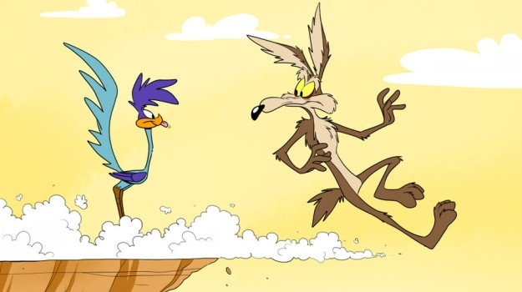
Acme – Pass/Fail
Criterion | Result | Pass/Fail
Transmittal Letter | Included
Payment & Performance Bonds | Can meet bonding requirements.
Eligibility | No disbarments or suspensions.
Experience | > 15 years experience in planning, engineering, construction, operations & maintenance
Financial Capability | Financially sound. Will need to attract additional financing and will require government support

Slide 15
Acme Qualifications – Evaluation Criteria
Criteria | Submission | Score
Experience with similar projects (30 points) | Multinational construction firm, headquartered in Canada with limited PPP experience.
Management & key personnel (30 points) | Senior management located in Canada. Assigning talented but relatively young personnel. Will self-perform planning, engineering and construction.
Use of local contractors (5 points) | Will include local firms as subcontractors.
Understanding of project scope (15 points) | “Government wants a quality terminal with quality shopping and offices.”
Understanding of risks (10 points) | “Risks should be equitably allocated.”
Safety record (10 points) | Within industry standards.
Total

Slide 16




Results
Proposer | Compliance (Pass/Fail) | Score
AJM
Gargantuan
Ned White
Buttarazzi
Acme

Slide 17



